Slide 1

Collaborating on code Version control systems with git and github
Dr. Jason B. Shepherd

Slide 2
Our Timeline for “Collaborating on Code”
Read up through Section 2.4 “Undoing Things” before the third day of class.
I will “lift” up some core ideas from the reading.
You should familiarize yourself with the mechanics (e.g., “How do I add changes I forgot to a previously performed commit?”)
On the third day of class, we will dive deeper into:
Git branching and merging
GitHub Issues and Pull Requests

Slide 3
Introduction
A Version Control System (VCS) is software that tracks changes to a set of files in a repository
Local VCS – one user
Centralized VCS – multiple collaborators, central server, files are checked-out/reserved
Distributed VCS – multiple collaborators, everyone has a full mirror of the repo
Git
Distributed VCS developed by Linus Torvalds when BitKeeper stopped being free-of-charge
Popular because of branching/merging capabilities
Popular hosting service for Git repositories with added tools (HTML repo browsing, Wikis, Issue/Milestone mgmt., etc.)

Slide 4
Simple workflow
git clone <repo_url>
cd <repo_name>
git add <file_or_dir>
...
git add <file_or_dir>
git commit -m "message here...”
git push origin master
One time only
Can repeat to add more changes before pushing to collaborators

Slide 5
No!
If you only know commands, you’ll fall into this trap.
If you actually understand how Git works internally, this needn’t be you.
https://xkcd.com/1597/

Slide 6
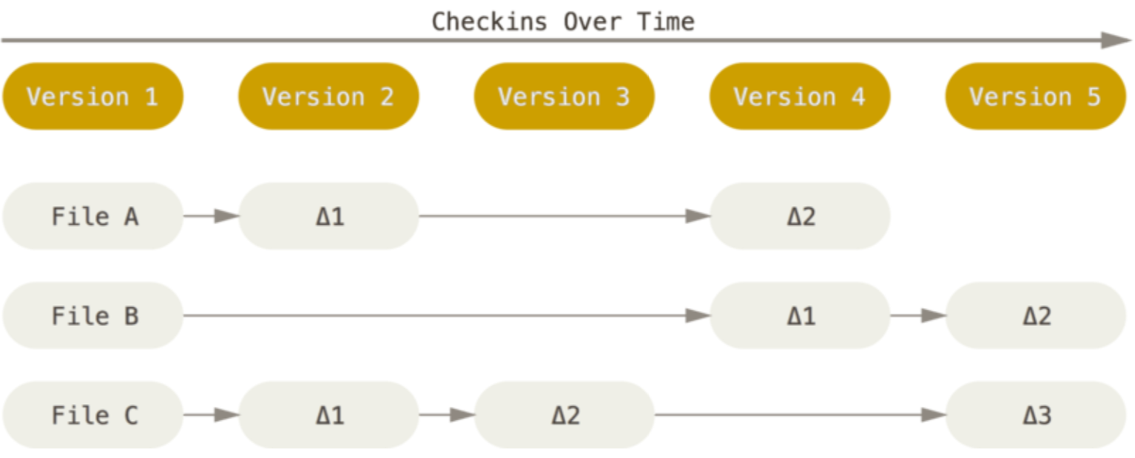
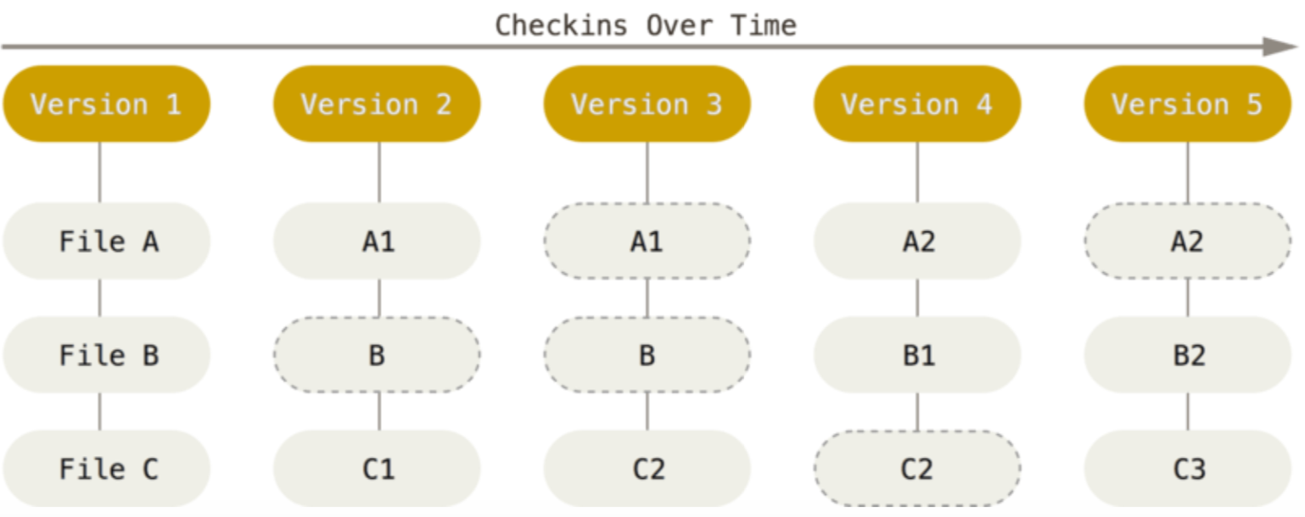
How other VCS’s do it (delta-based).
How Git does it
(snapshot-based).
Dashed ovals show that a pointer to the file has not changed.
Figures from Pro Git by Chacon and Straub

Slide 7
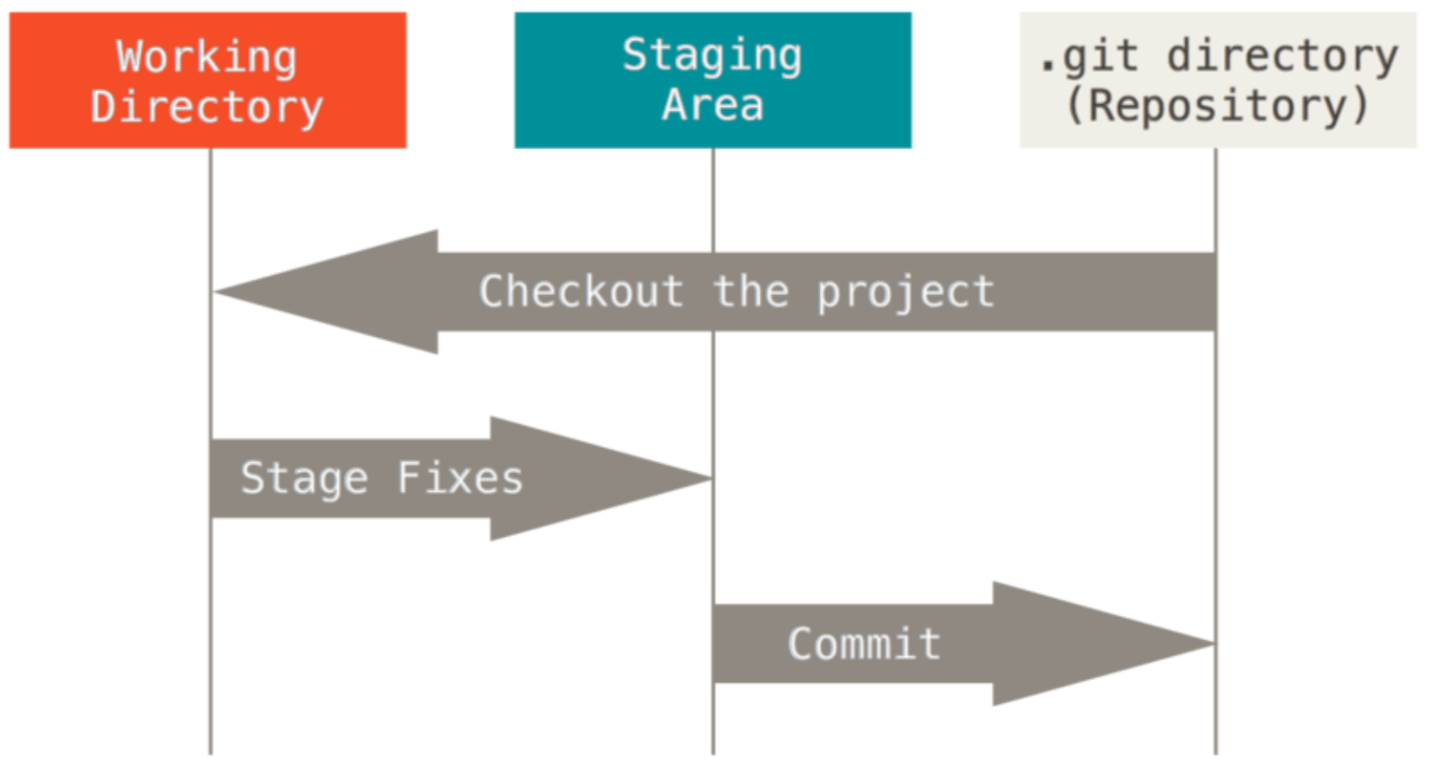
A single checkout of one version of the project.
git checkout master
git checkout 55c4277
The index that stores information for your next commit.
Local repo with objects and version metadata.
Figures from Pro Git by Chacon and Straub

Slide 8
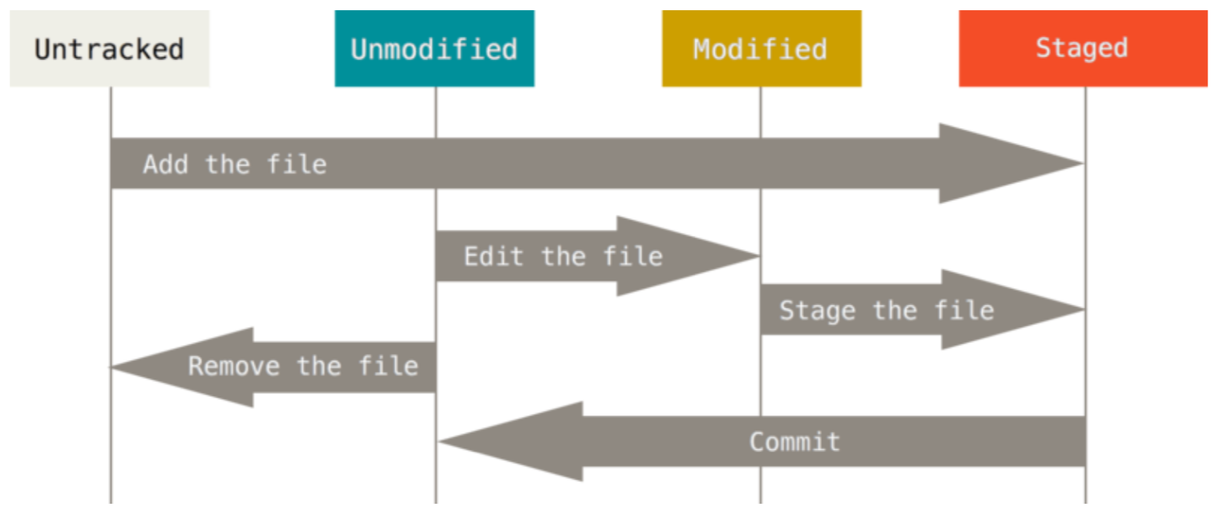
Lifecycle for a file in Git
Figures from Pro Git by Chacon and Straub

Slide 9
Things get interesting when we start involving multiple collaborators…

Slide 10
Scenario 1 between jbshep and jbshepspam
Jbshep clones
Jbshepspam clones
Jbshep adds, commit, push
Jbshepspam adds, commit, push (oh no!)
----
Jbshepspam git pull (file now has merge stuff… previous commit is thrown away)
Jbshepspam edit file
Jbshepspam add, commit, push
Do ‘git log’ on both Terminals
Jbshep needs to do git pull (assuming he has no changes locally)

Slide 11
Notice the labeling on ‘git log’ output
Each commit has its own unique hash
We can refer to this hash (or just part of the beginning of it) when we perform different operations
Example: git checkout 55c4277

Slide 12
Scenario 2 between jbshep and jbshepspam
Jbshep and jbshepspam are sync’ed
Jbshep makes a change to new file but does not add, commit, or push yet
Jbshepspam makes a change to existing file, adds, commits, and pushes
Jbshep adds, commits, tries to push… error! Remote has changes jbshep doesn’t have.
Jbshep tries git pull… previous push attempt already grabbed existing file changes
Jbshep tries to push again. Previous commit was already thrown away. Need to recommit.
Jbshep commits, pushes
Jbshepspam is behind and must git pull to catch up

Slide 13
Assignment A2
An in-class assignment
Instructions: https://github.com/jbshep/softeng19/blob/master/asgn/a2.md
Repo: https://github.com/jbshep/softeng19-a2/

Slide 14
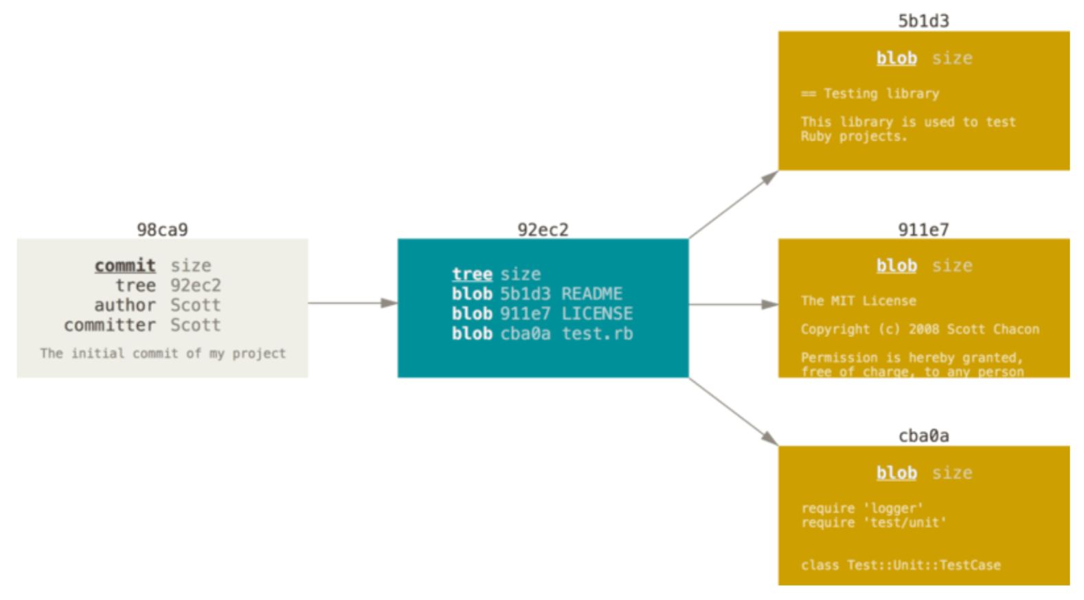
The anatomy of a commit
Figures from Pro Git by Chacon and Straub

Slide 15
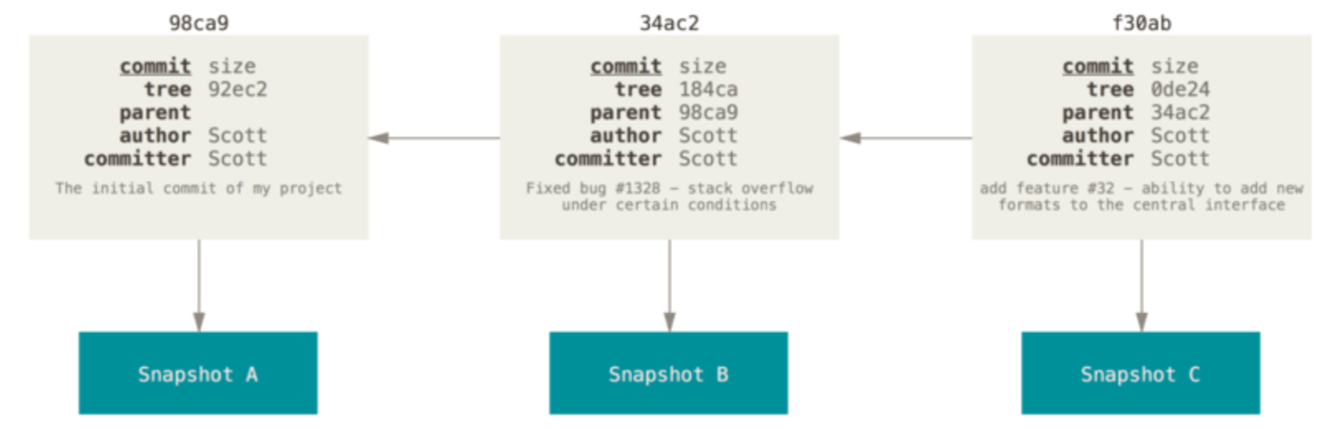
A series of commits
Figures from Pro Git by Chacon and Straub

Slide 16
Branches
A branch is a lightweight movable pointer to a commit.
Default branch is named master.
master points to your last commit in the master branch.
With each new commit, the master pointer moves forward automatically.
(Technically, you can renamed the main branch something other than “master” but please don’t).
Our working directory has a HEAD pointer.
HEAD points to the last commit.
HEAD points to master unless you change it.

Slide 17
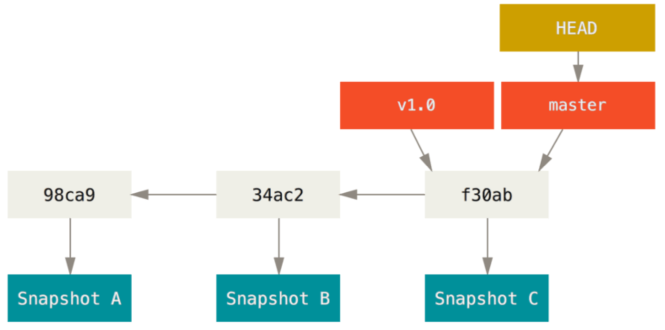
Figures from Pro Git by Chacon and Straub

Slide 18
Creating branches
git branch <branch-name> creates a new branch
git checkout <branch-name> resets HEAD to branch-name
git checkout -b <branch-name> creates a new branch and switches to it

Slide 19
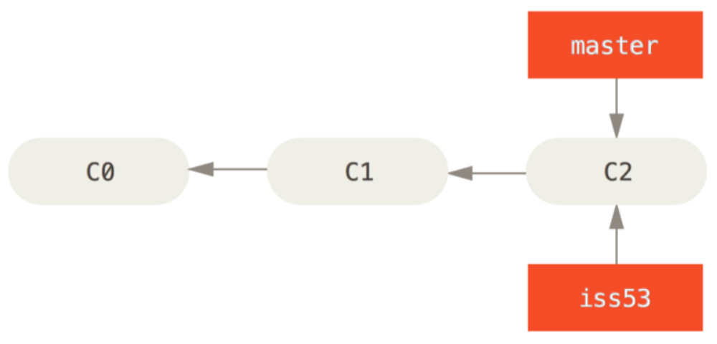
Figures from Pro Git by Chacon and Straub

Slide 20
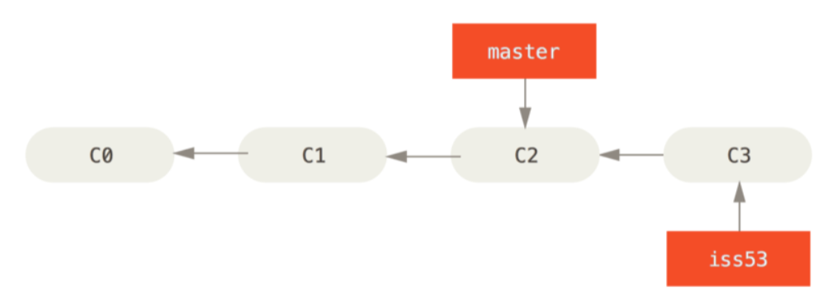
Figures from Pro Git by Chacon and Straub

Slide 21
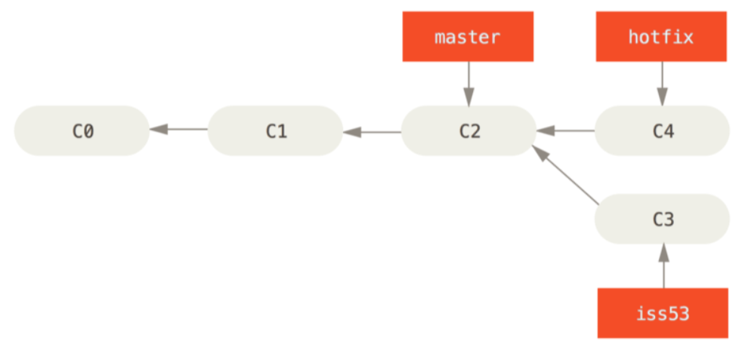
Figures from Pro Git by Chacon and Straub

Slide 22
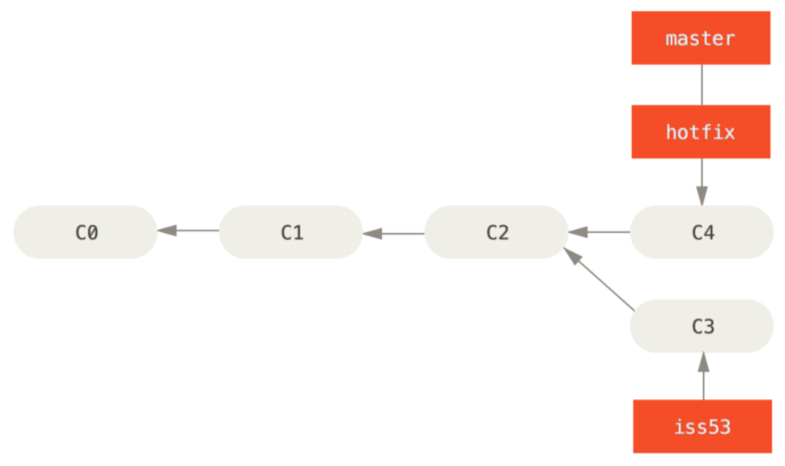
Merging back to master
git checkout master
git merge hotfix
Figures from Pro Git by Chacon and Straub

